Slide 1
Yelp Rating Prediction
Yuanyuan Lin

Slide 2
Table of Content
Exploratory Data Analysis
Sentiment Analysis on Customer Reviews
Mapping for Restaurants
Cluster Analysis
Topic Modeling
PCA

Slide 3
Introduction
Significant rise in the importance of customer reviews
Yelp is currently the most widely used restaurant across United States.
Yelp rating prediction could help improve Yelp user’s experience.
Use Latent Dirichlet allocation(LDA) for topic modeling

Slide 4
EDA
As the world cloud graph show below, we found the most common words are “food”, “time” and “service”, “nice”, “love” and “service”. We would like to learn the importance of having high quality of service in restaurants.

Slide 5
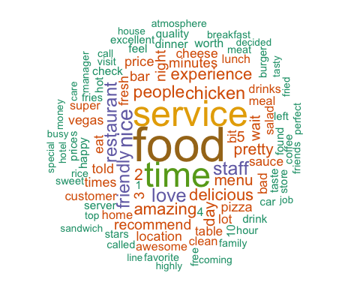

Slide 6
Most Common Words in Review
word | n
food | 10156
service | 7345
time | 7070
nice | 3691
love | 3159
staff | 3089

Slide 7
Sentiment Analysis on Customer Reviews

Slide 8
Used bing to get sentiment count by doing single word and bigram analysis.
Process the opinion for restaurants computationally for identifying and categorizing it

Slide 9
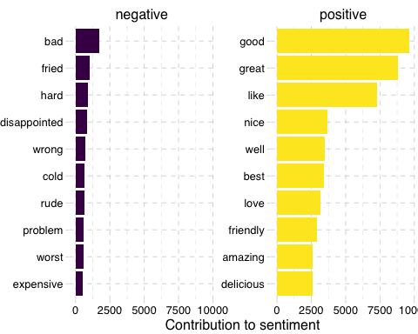
Most Common Positive and negative words

Slide 10
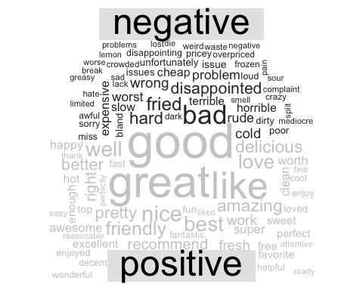
Word Map on Sentiment Analysis

Slide 11
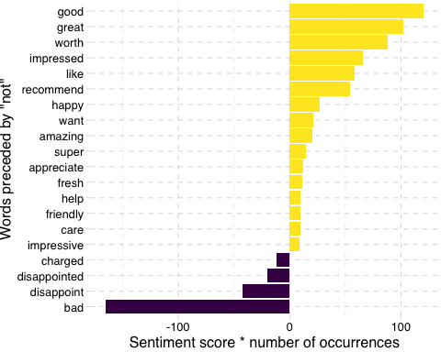
Most Frequent Words that are preceded by “not”

Slide 12
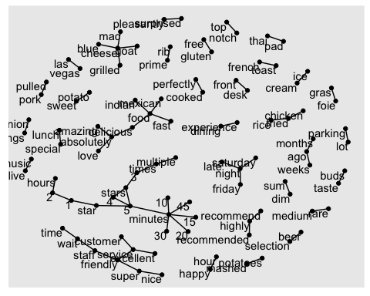
Common Bigram Graph

Slide 13
Mapping to Location Restaurant in OH
The result of the distribution of yelp restaurants in OH does not looks good in leaflet since the pop-up logo is too large on the graph. But using ggmap, it gets more clear on the graph. We are able to notice that most restaurats are centered around the capital of Ohio, which is Columbus.

Slide 14
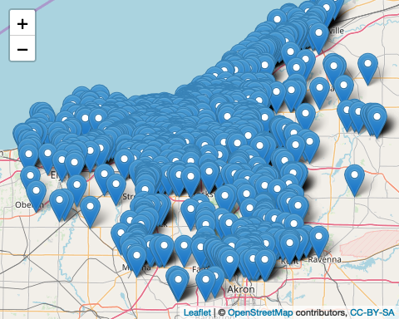

Slide 15
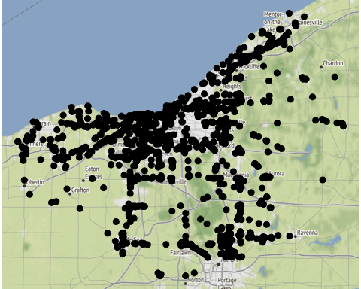
Mapping to Location Restaurant in OH

Slide 16
Cluster Analysis
applied the k-means cluster analysis
efficient model for classifying observations
available to have a general prediction for restaurants rating

Slide 17
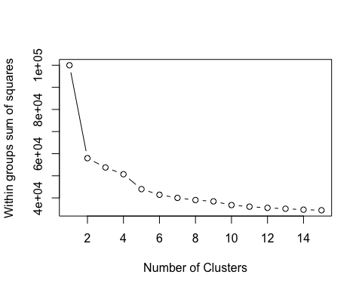
Cluster Analysis

Slide 18
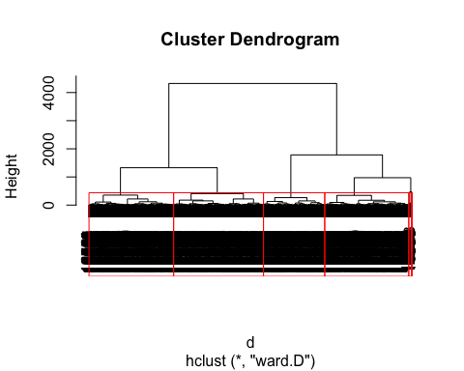

Slide 19
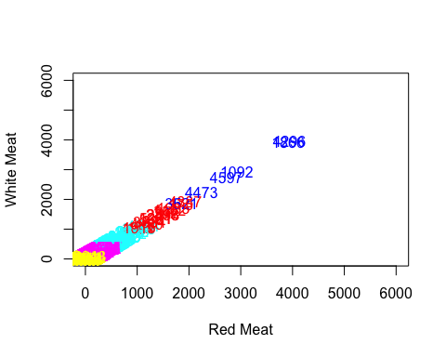

Slide 20
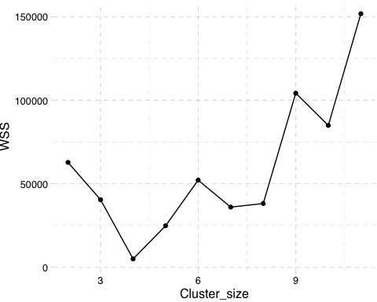
Cluster Analysis

Slide 21
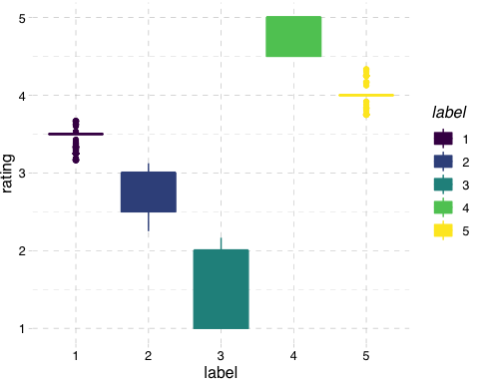
Cluster Analysis

Slide 22
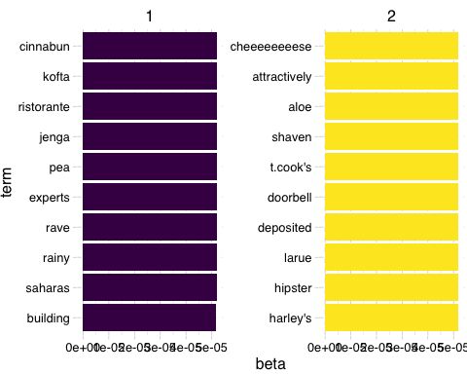
Topic Modeling

Slide 23
Topic Modeling

Slide 24
Create document term matrix for topic modeling.
Latent Dirichlet Allocation helps to discover latent themes in the restaurant texts descriptions.

Slide 25
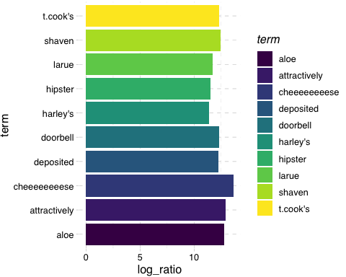
Topic Modeling

Slide 26
PCA
Principal Component Analysis is used to improve the prediction of star rating.
More detailed analysis of PCA and how it implements in regression can be found in the report

